Slide 1

Predicting Gold Stock Prices with Machine Learning
BY SENTHIL KUMARAN.M

Slide 2



Introduction
In this presentation, we will explore how
machine learning can be used to gold stock prices. We will discuss the
challenges and opportunities in this ﬁeld
and explore various for prediction.

Slide 3


Gold Stock Analysis
Understanding the historical trends and patterns in prices is crucial for accurate prediction. We will analyze the factors inﬂuencing gold prices and their impact on stock values.

Slide 4

Data Collection
High-quality data is essential for training accurate machine learning models. We will explore sources for gold stock data and discuss the importance of data preprocessing and cleaning.

Slide 5

Feature Engineering
Identifying and selecting the right feature
is critical for building effective prediction models. We will discuss techniques for feature selection and extraction in the context of gold stock prices.

Slide 6

Fundamental Analysis
IMarket Volatility: Gold prices can be influenced by various unpredictable factors, making accurate predictions challenging.
Data Quality: Using clean and accurate data is crucial for building reliable ML models.
Model Complexity: Balancing model complexity with the amount of data available is essential to prevent overfitting.

Slide 7

Machine Learning Models
Split the data: Separate the data into training and testing sets. Train the model on the training set and evaluate its performance on the unseen test set.
Performance metrics: Use metrics like mean squared error (MSE), root mean squared error (RMSE), or R-squared to evaluate model accuracy.
Prediction: Once the model is trained, use it to predict future gold prices based on new data.

Slide 8
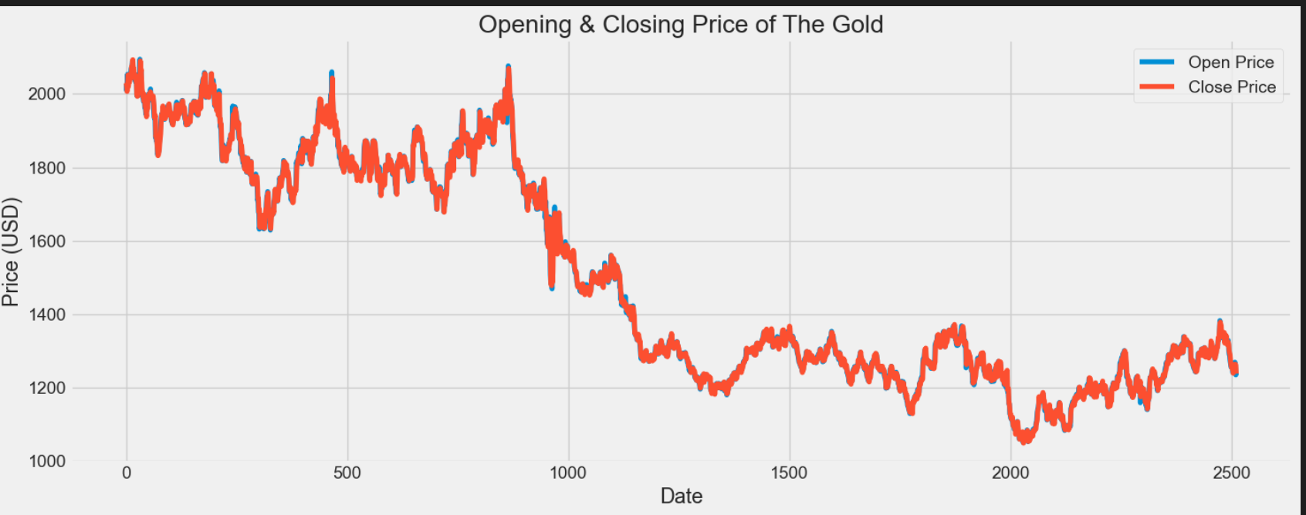
Volatility Analysis
Understanding Volatility is crucial for assessing the potential risk and uncertainty associated with gold prices. Analyzing historical volatility and implied volatility can aid in developing robust price prediction models.

Slide 9
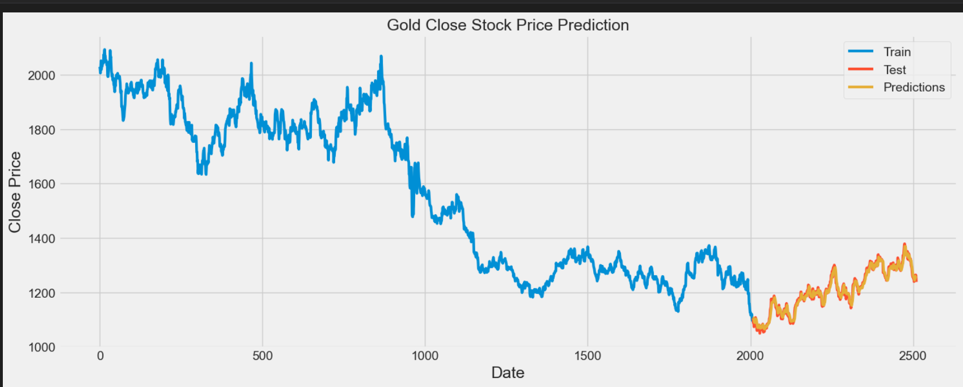
Forecasting Methods
Exploring various forcasting methods
such as time series analysis, regression models, and ensemble methods can provide diverse perspectives on gold price predictions. Combining multiple methods can enhance prediction accuracy.

Slide 10

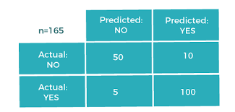
Evaluation Metrics
Measuring the performance of prediction models requires the use of Evaluation Metrics such as RMSE, MAE, and R- squared. We will discuss the signiﬁcance
of these metrics in assessing model accuracy.

Slide 11


Conclusion
In conclusion, we have explored the potential of Machine language in
predicting gold stock prices. While challenges exist, the use of advanced
algorithms and data analysis techniques can lead to more accurate predictions and
informed decision-making in the gold market.

Slide 12
Thanks!
Do you have any questions? senthilkumaran0411@gmail.com @senthilkumaran

